Slide 1
(Chapter 3)
Advanced Java Programming
Notes:
Riddhi Patel (Lecturer at LDRP-ITR)

Slide 2
(Chapter 3)
Advanced Java Programming
ONE WAY COMMUNICATION
Notes:
Riddhi Patel (Lecturer at LDRP-ITR)

Slide 3
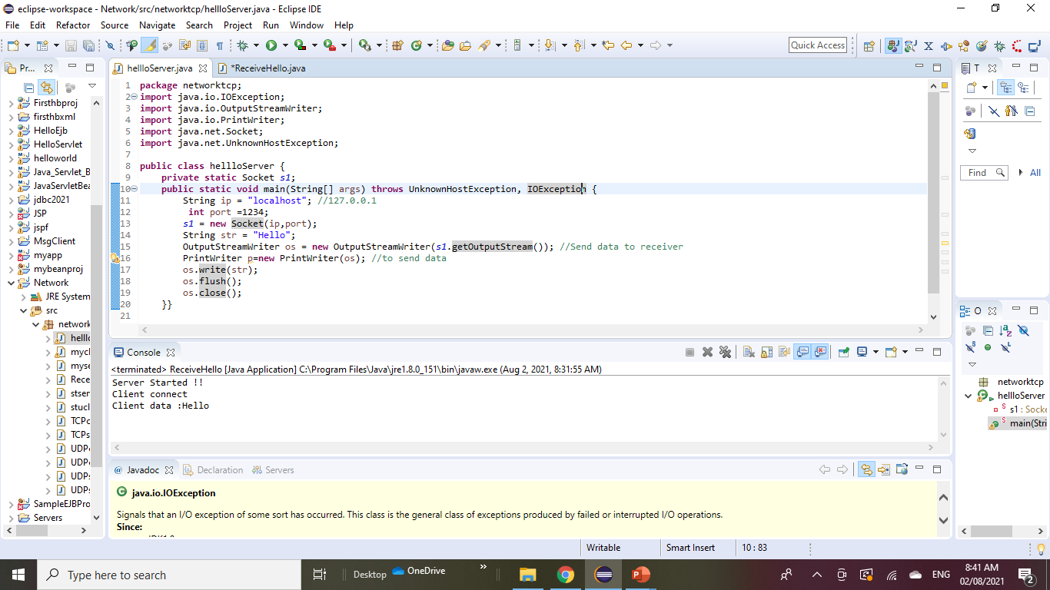
Client
Notes:
Riddhi Patel (Lecturer at LDRP-ITR)

Slide 4
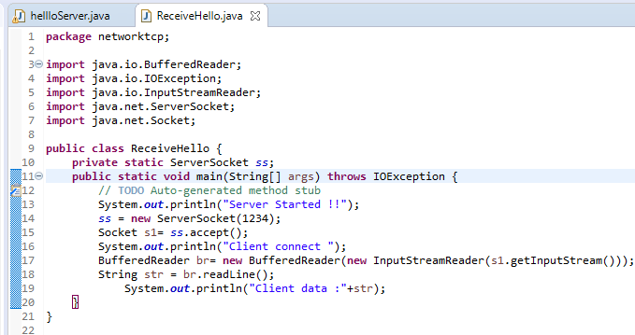
Server
Notes:
Riddhi Patel (Lecturer at LDRP-ITR)

Slide 5
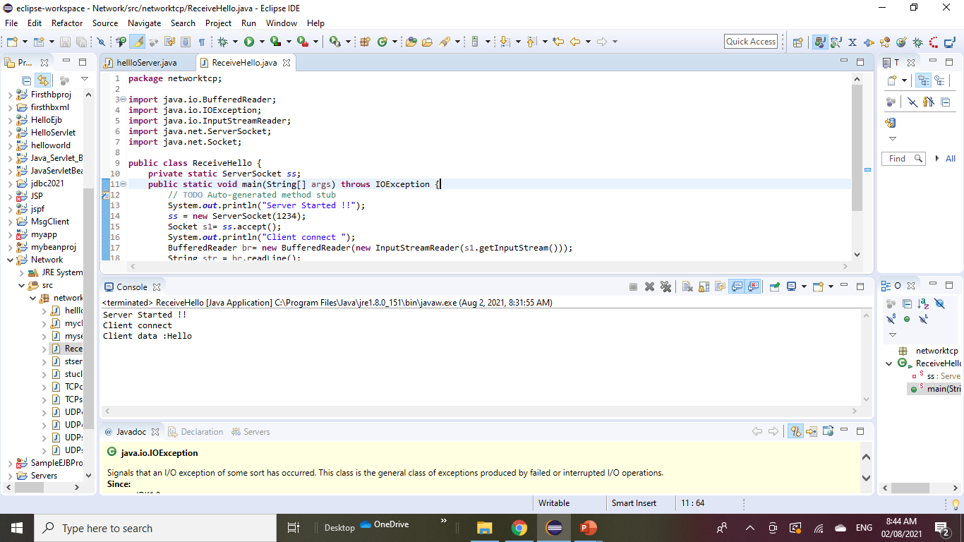

Slide 6
(Chapter 3)
Advanced Java Programming
TCP :TWO WAY COMMUNICATION
Notes:
Riddhi Patel (Lecturer at LDRP-ITR)

Slide 7
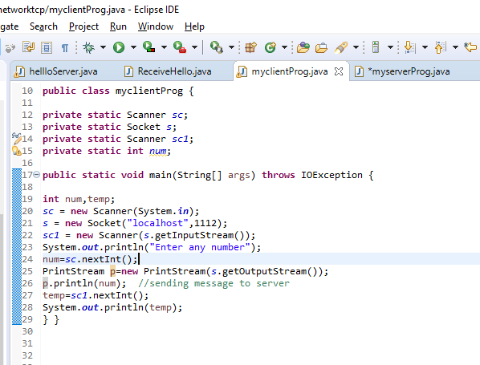
Client side

Slide 8
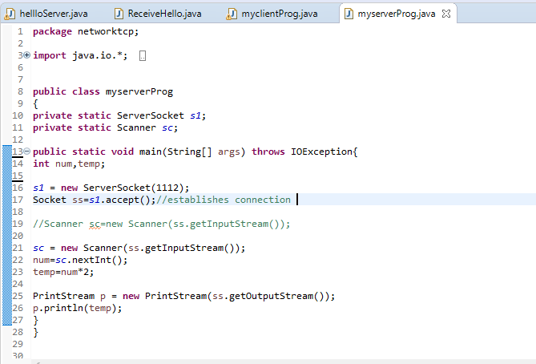
Server side

Slide 9
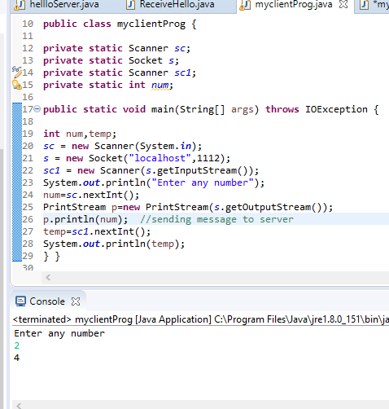
OUTPUT

Slide 10
(Chapter 3)
Advanced Java Programming
UDP :TWO WAY COMMUNICATION
Notes:
Riddhi Patel (Lecturer at LDRP-ITR)

Slide 11
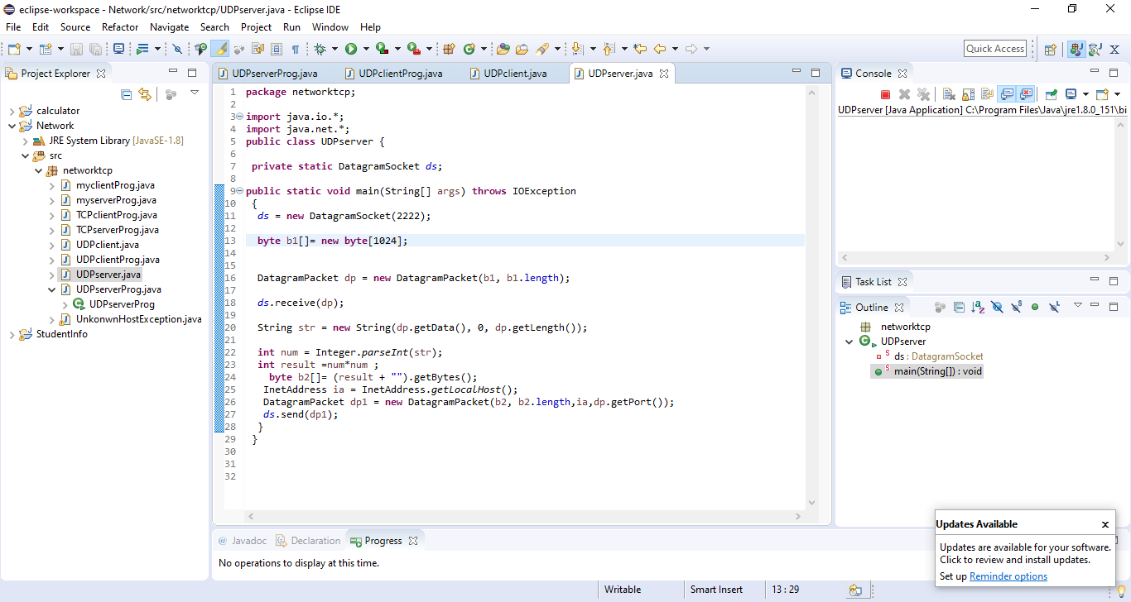

Server side

Slide 12
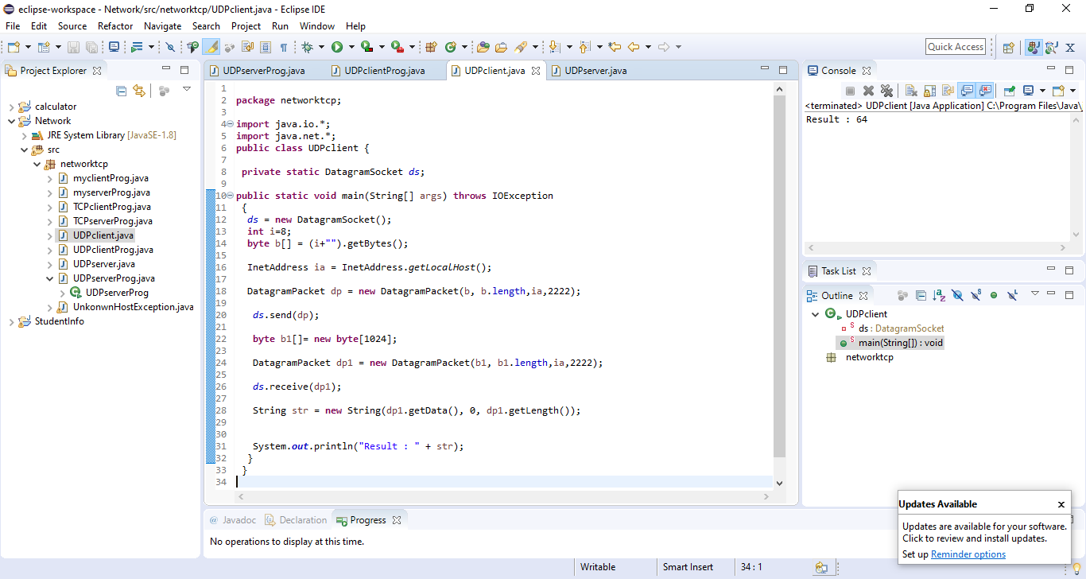
Client side

Slide 13
(Chapter 3)
Advanced Java Programming
UDP CHAT APPLICATION
Notes:
Riddhi Patel (Lecturer at LDRP-ITR)

Slide 14
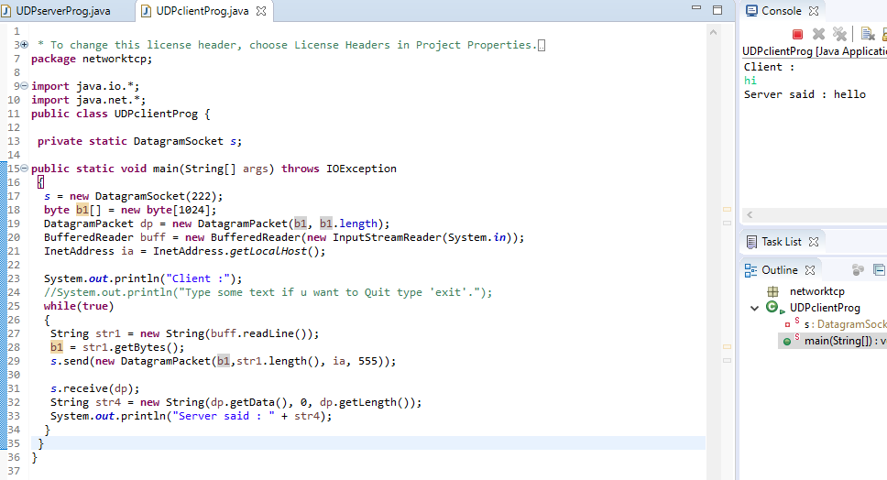
Client side
Notes:
Riddhi Patel (Lecturer at LDRP-ITR)

Slide 15
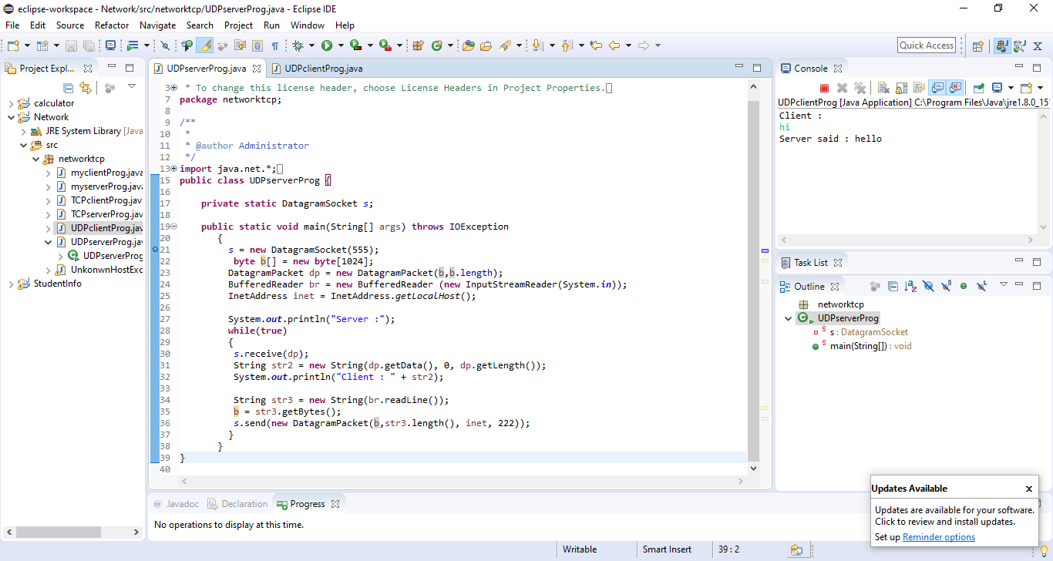
Server side
Notes:
Riddhi Patel (Lecturer at LDRP-ITR)

Slide 16
(Chapter 3)
Advanced Java Programming
TCP :CHAT APPLICATION
Notes:
Riddhi Patel (Lecturer at LDRP-ITR)

Slide 17
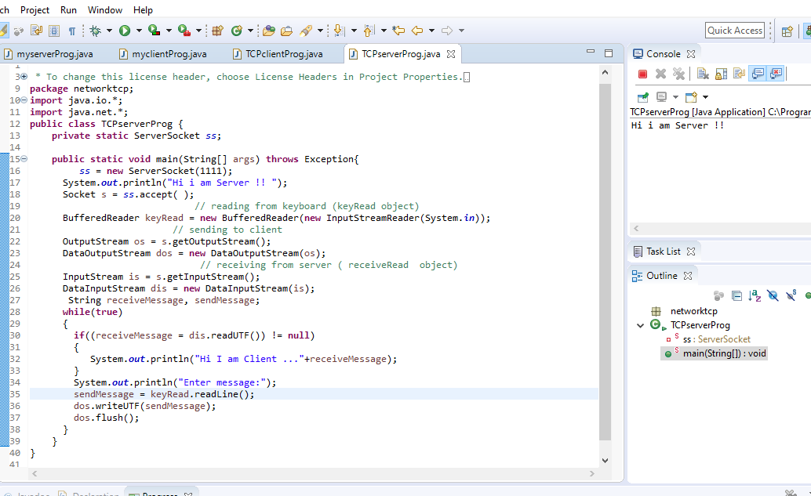
Aim: create chat

Slide 18
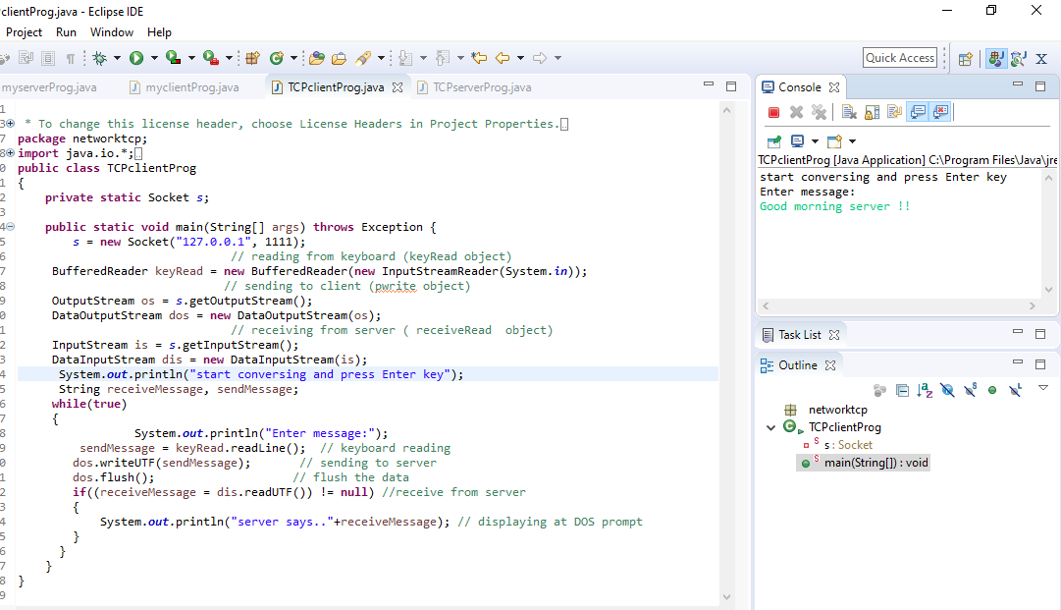
Client side

